Slide 1
Day 29
Geometric Dilution of Precision

Slide 2
Trilateration
given two landmarks with known locations we can compute the two possible locations of the robot
additional information will tell us which of the two locations (heading information, landmarks are on a wall, etc.)
d₁
d₂
landmark
landmark

Slide 3
Trilateration
assume
red landmark is located at the origin
blue landmark is located a units along the x axis
then the robot is located at:
d₁
d₂
[0 0]^{T}
[0 a]^{T}

Slide 4
Trilateration
if the distance measurements are noisy then there will be some uncertainty in the location of the robot

Slide 5
Trilateration
notice that the uncertainty changes depending on where the robot is relative to the landmarks
uncertainty grows quickly if the robot is in line with the landmarks

Slide 6
Trilateration
uncertainty grows as the robot moves farther away from the landmarks
but not as dramatically as the previously slide

Slide 7
Geometric Dilution of Precision
it many cases it might be nice to know how the uncertainty changes as a function of the robot position
i.e., how much variation is there in the estimated position for some amount of variation in the distance measurements
called the geometric dilution of precision
where ΔX is the variation in the estimated pose (in this case, position) and ΔS is the variation in the sensor readings (in this case, distance)

Slide 8
Geometric Dilution of Precision
if we take the limit as ΔS→0 then the GDOP is equal to the Jacobian of the measurement equation
*positive root only
*different than textbook

Slide 9
Geometric Dilution of Precision
if the Jacobian is a square matrix, then we can examine its determinant
the absolute value of the determinant tells you something about how much x and y will change
the textbook calls the absolute value of the determinant the magnitude of J

Slide 10
Geometric Dilution of Precision

Slide 11
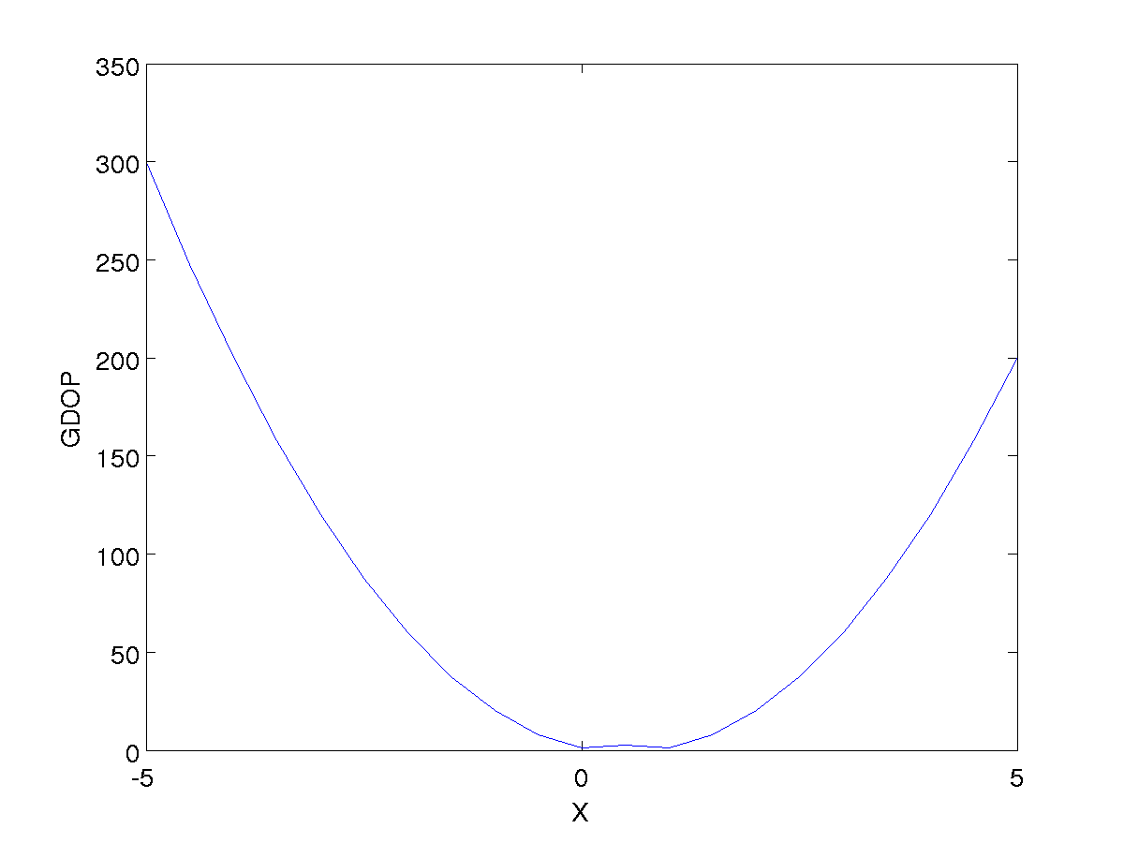
Geometric Dilution of Precision
the GDOP is very sensitive to changes in x along the y axis

Slide 12
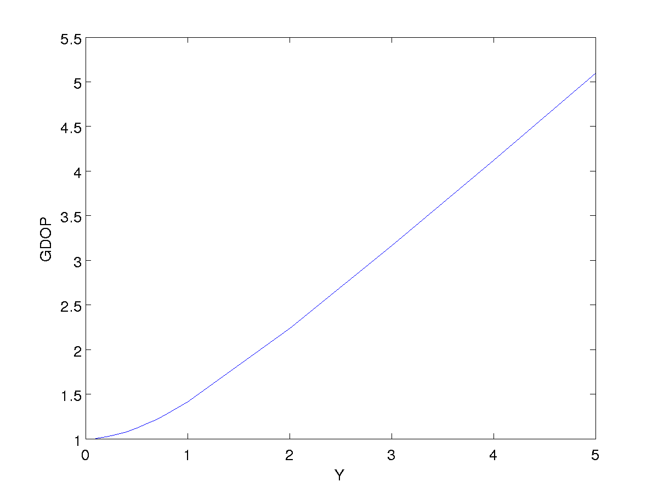
Geometric Dilution of Precision
the GDOP is less sensitive to changes in y along the x axis

Slide 13
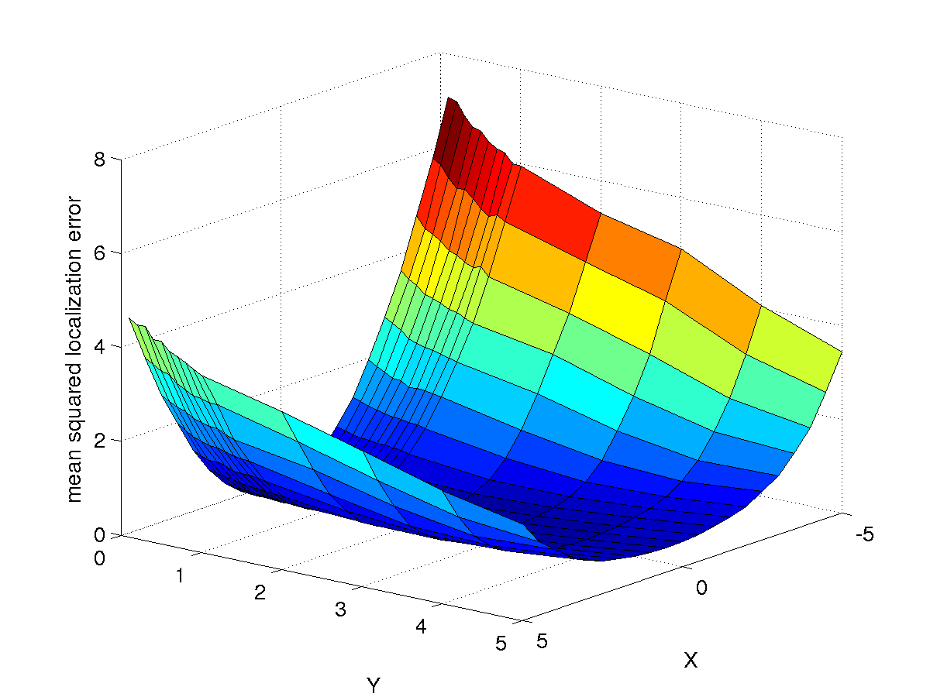
Geometric Dilution of Precision
simulated localization error

Slide 14
similar problems appear in other research fields

Slide 15
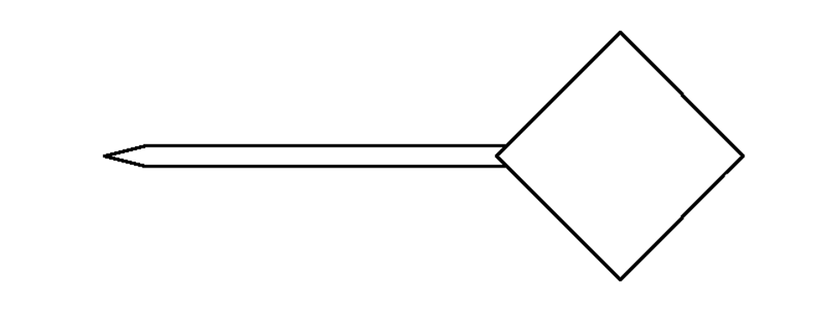
Registration Error
model pointer
Suppose we have a tracked pointing stylus with a DRB having 4 fiducial markers.

Slide 16
Registration Error
actual pointer
Because the of measurement errors in the tracking system, the locations of the
fiducial markers cannot be measured exactly. The error between the actual and
measured marker locations is called the fiducial localization error (FLE).

Slide 17
Registration Error
minimize : Σ ( FRE_{i} )²
actual pointer
model
pointer
fiducial registration
error ( FRE_{i} )
When the model pointer is registered to the measured pointer, the FLE will
lead to some error in the estimated rotation and translation. The residual
errors in the fiducial locations after registration is called the fiducial registration
error (FRE).

Slide 18
Registration Error
actual pointer
target registration
error (TRE)
Usually, we are interested in points that are not fiducial locations. Any such
point (not used for registration purposes) is called a target. The error between
the true target position and registered target position is called the target
registration error (TRE).

Slide 19
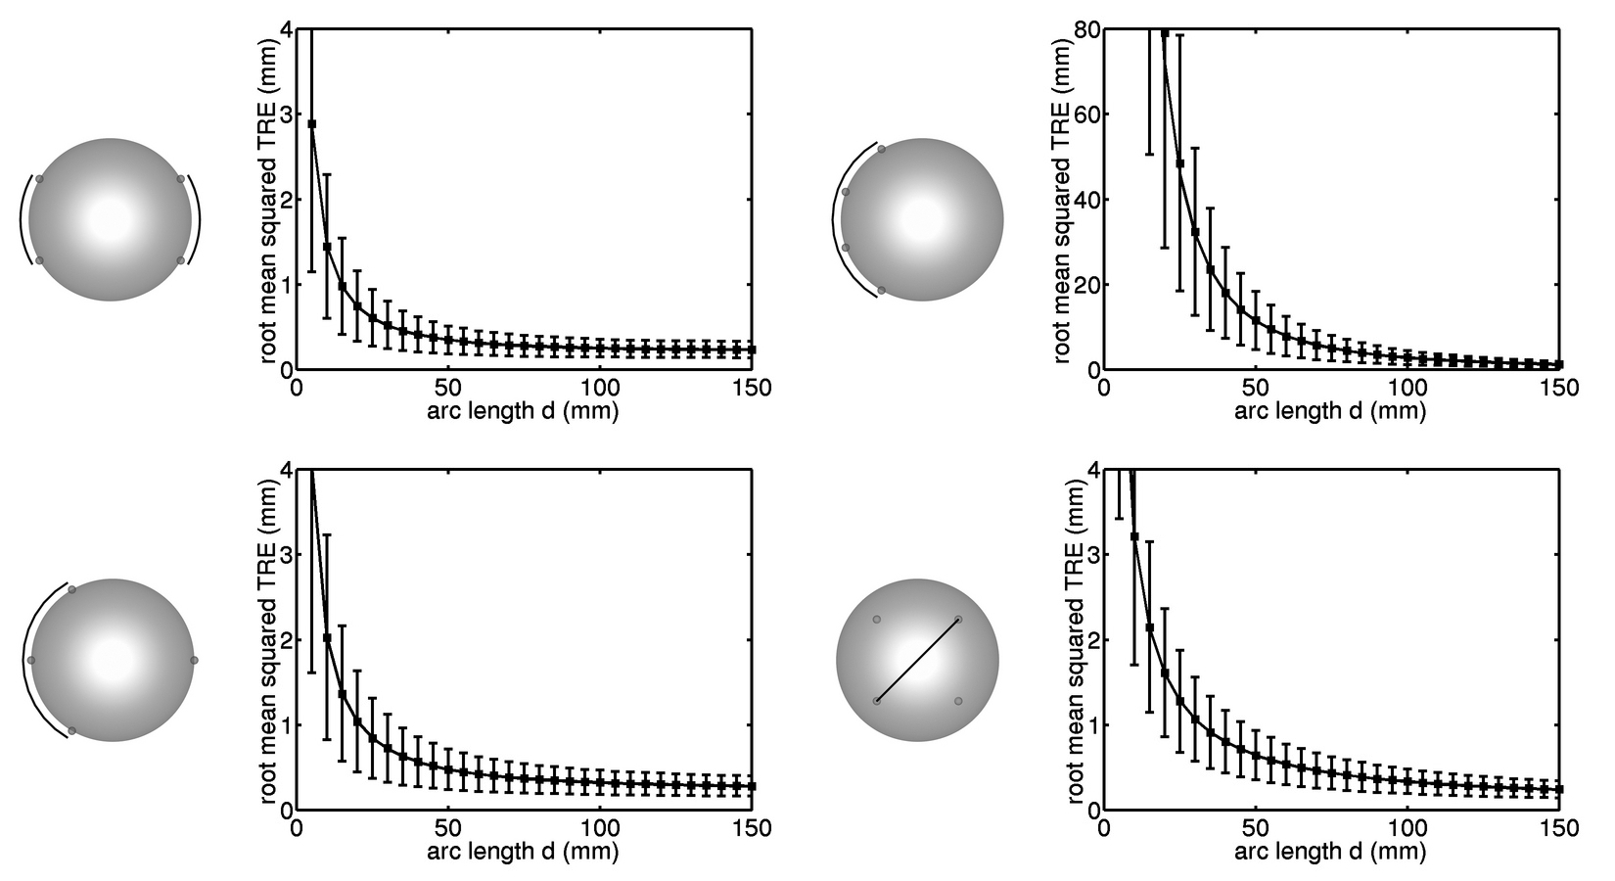
Analysis of TRE
TRE for different configurations of markers

Slide 20
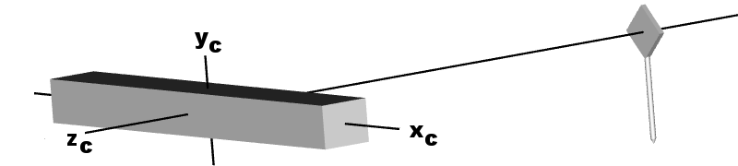
Anisotropic FLE
what happens if the DRB rotates about x-axis?

Slide 21
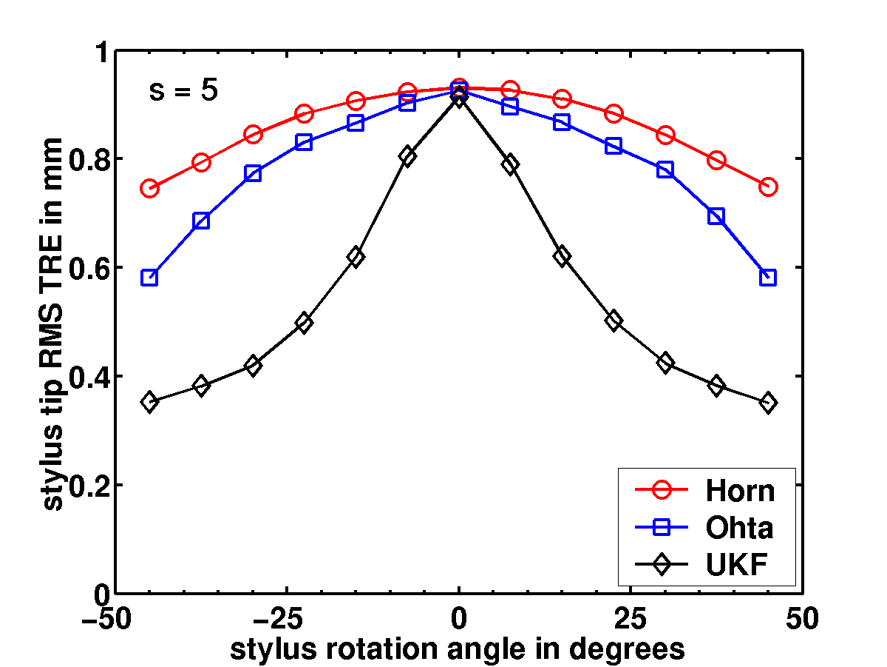
Anisotropic FLE
TRE strongly dependent of rotation for anisotropic noise

Slide 22
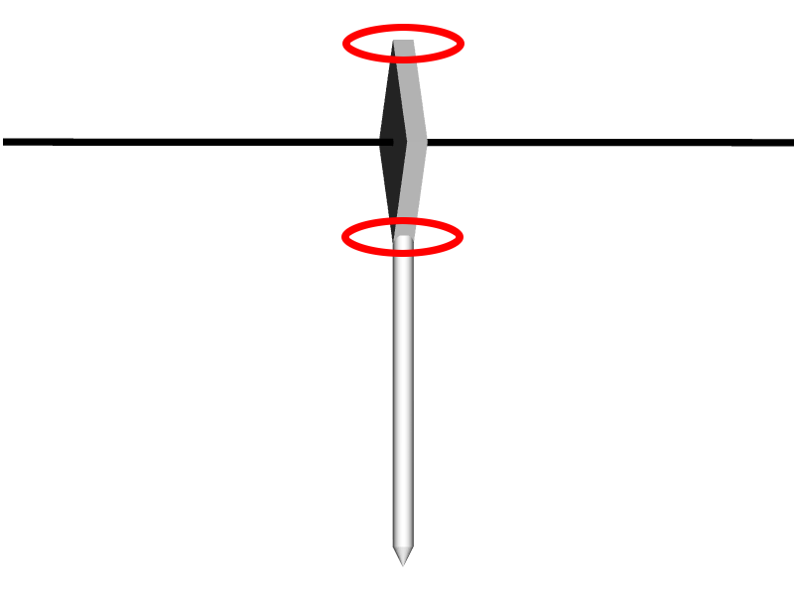
Why the Peak in TRE?
because rotational component of TRE_{RMS} is maximized when DRB faces the tracking camera

Slide 23
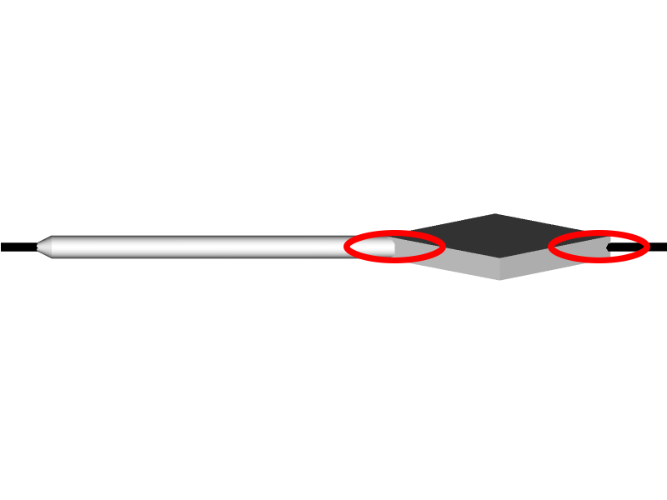
Why the Peak in TRE?
and minimized when the DRB is perpendicular to the tracking camera

Slide 24
Observed TRE
paradoxically, this behavior is exactly the opposite of what is observed in practice
TRE is typically worse when the DRB is rotated away from the camera

